Slide 1
Global Shift of Manufacturing Industries
Pull and Push Factors that industries leave HK (Experiential Learning)

Slide 2

All Groups observed through Five Senses
Many people / Foreigners / there are some shopping malls
Different kinds of food
Old and tall buildings around us
People are sending leaflets, eating, talking and selling electronic products
Restaurants, food shops, shoe shops, some make-up shops
People used smart phones
Cars (buses and trucks)
A lot of banners

Slide 3
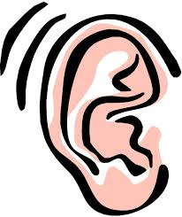
All Groups observed through Five Senses (Experiential Learning)
Shop owners’ yelling
People are doing promotion ✓ ✓
Sounds from the cars and engines ✓ ✓ ✓ ✓ ✓ ✓ ✓
People are talking ✓ ✓
Exhaust pipe from the factory building
Some shops are playing music
Construction

Slide 4

All Groups observed through Five Senses
Water from the air-conditioners ✓
Leaflets
Hand rail
Hit each other (crowded)
Exhaust gas is warm
Fence
Traffic lights
Wall of the buildings
Egg puff

Slide 5


All Groups observed through Five Senses
Smell of food ✓
Bad Smell from cars ✓✓
People are smoking ✓✓
Bad smell from rubbish
Sweet (egg puff) ✓ ✓
Salty (Siu mai)
Cold (Soft drinks)

Slide 6
What have you learnt during and after the visit?
Kwun Tong is really a busy and noisy district. It is very crowded.

Slide 7

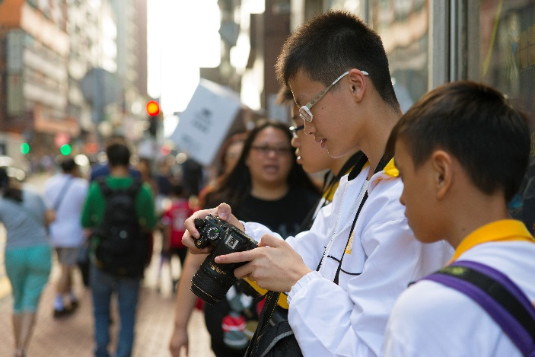
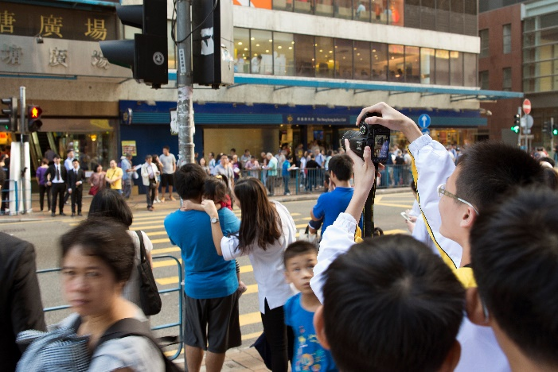
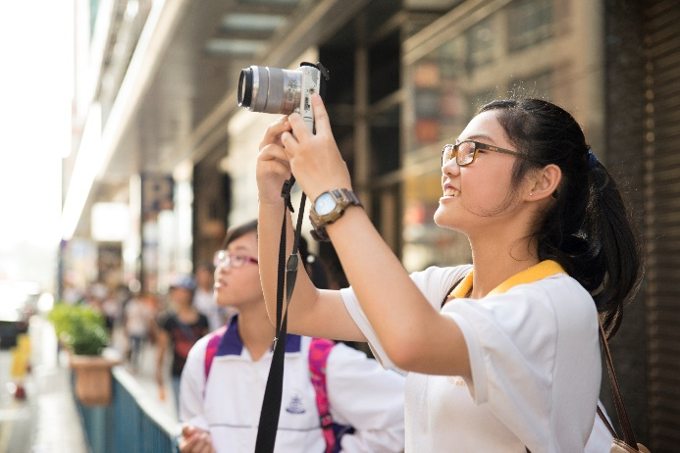
Do your observations match with the history of Kwun Tong?
[街導時光機系列] 觀塘－開源道(歷史篇)

Slide 8


Many people / Foreigners / there are some shopping malls Different kinds of food Old and tall buildings around us People are sending leaflets, eating, talking and selling electronic products Restaurants, food shops, shoe shops, some make-up shops People used smart phones Cars (buses and trucks) A lot of banners | Shop owners’ yelling People are doing promotion Sounds from the cars and engines People are talking Exhaust pipe from the factory building Some shops are playing music Construction | Water from the air-conditioners Leaflets Hand rail Hit each other (crowded) Exhaust gas is warm Fence Traffic lights Wall of the buildings Egg puff | Smell of food Bad Smell from cars People are smoking Bad smell from rubbish | Sweet (egg puff) Salty (Siu mai) Cold (Soft drinks)
Matched!!!
Kwun Tong is really a busy and noisy district. It is very crowded. But is there any change now?

Slide 9
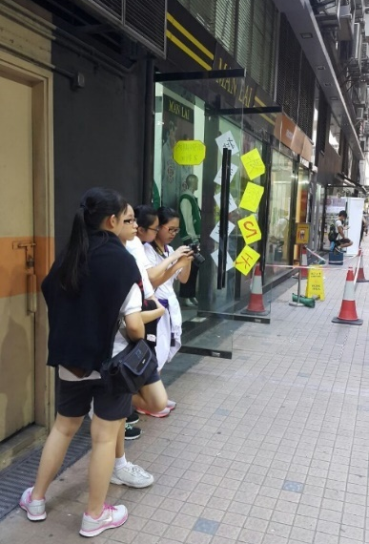
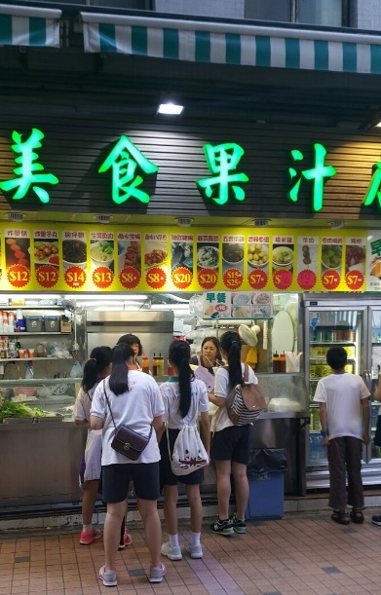
Do your observations match with the change of Kwun Tong?
1950s
* HK changed from an entrepot to an industrial city. (No heavy and high-polluted industries, mainly textile, light and painting industries.)
1960s
* Urban development
now
* Factories are still here but the uses are changed.
香港故事-走過觀塘五十年
Factories moved back to Mainland
Economic Restructuring

Slide 10
Factors that manufacturing industries leave HK
Rise in land rent
Low wages
Favourable government policies
Lack of government support
Cheap land rent
Close to HK
Increase in wages
Strict pollution controls

Slide 11
Pull Factors | Push Factors
1. Low wages | 1. Increase in wages
2. Cheaper land rent | 2. Rise in land rent
3. Favourable government policies | 3. Lack of government support
4. Close to HK | 4. Strict pollution controls

Slide 12
The Present and Future of Kwun Tong
Dream Building

Slide 13
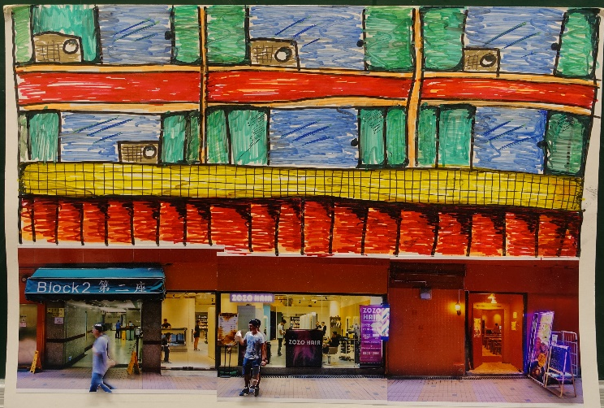
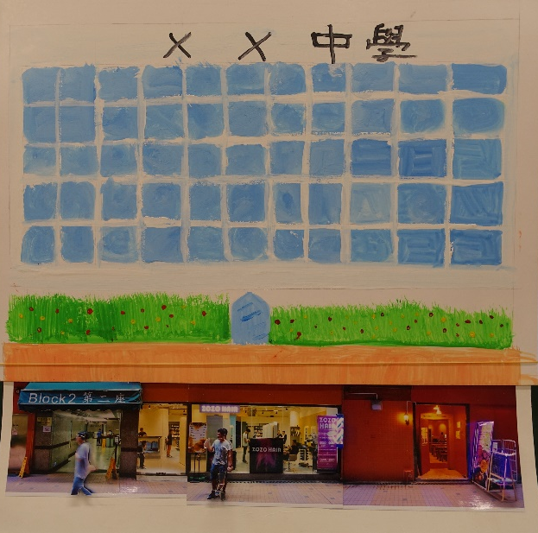
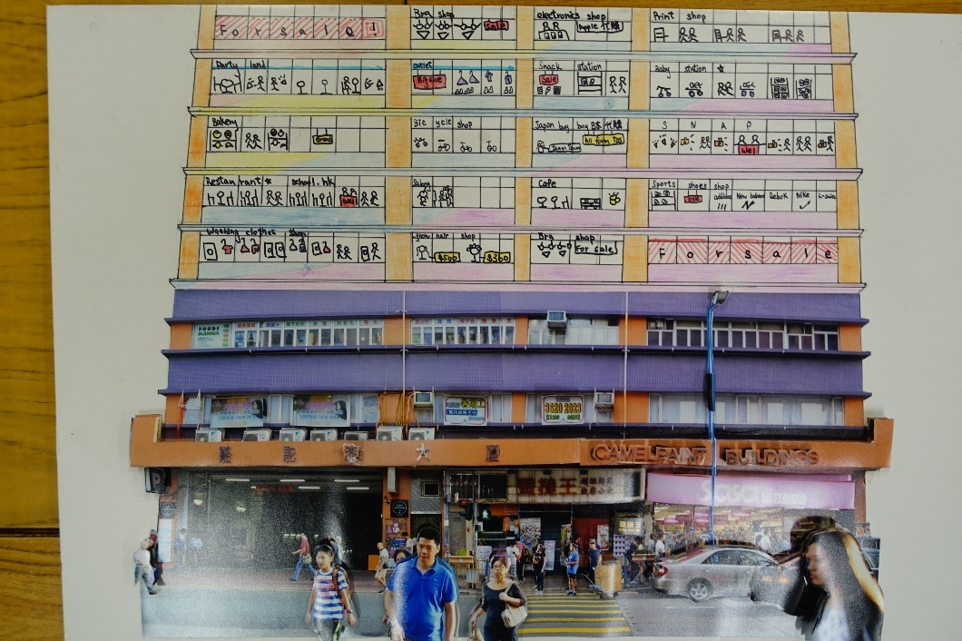
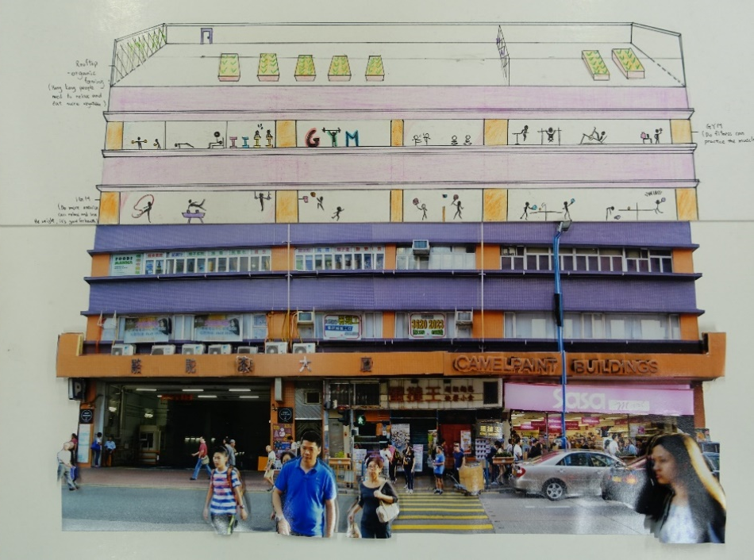
School
Organic Farming/
Gym

Slide 14
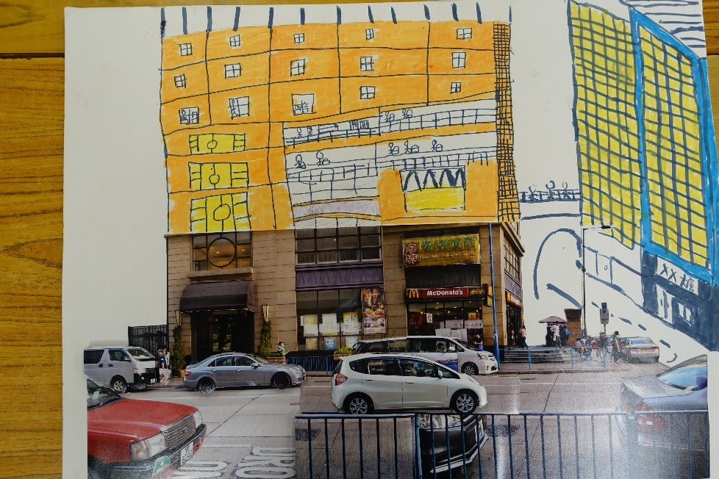
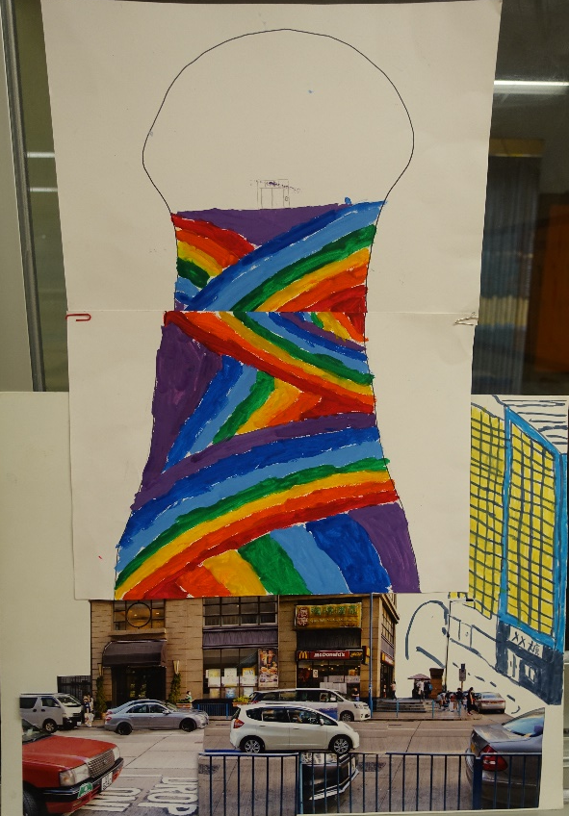
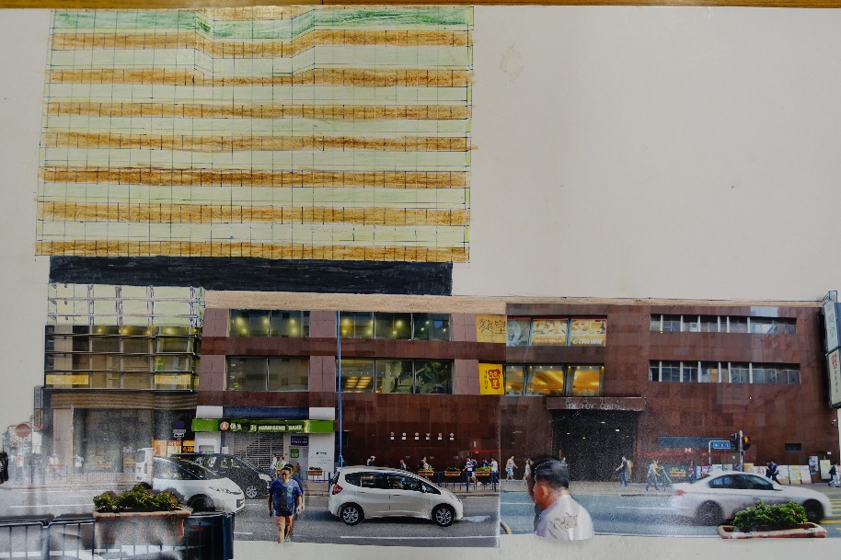
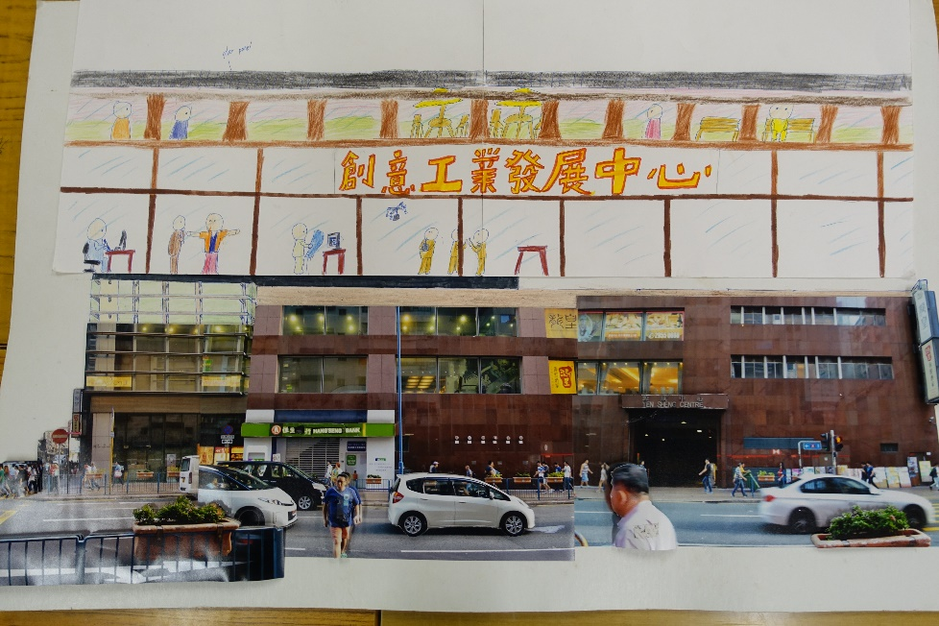
Creative industrial centre

Slide 15
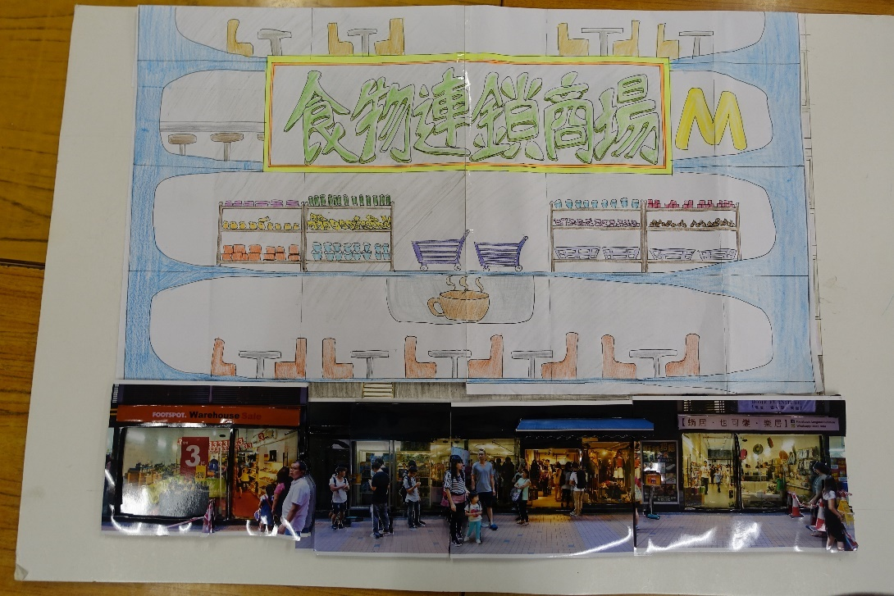
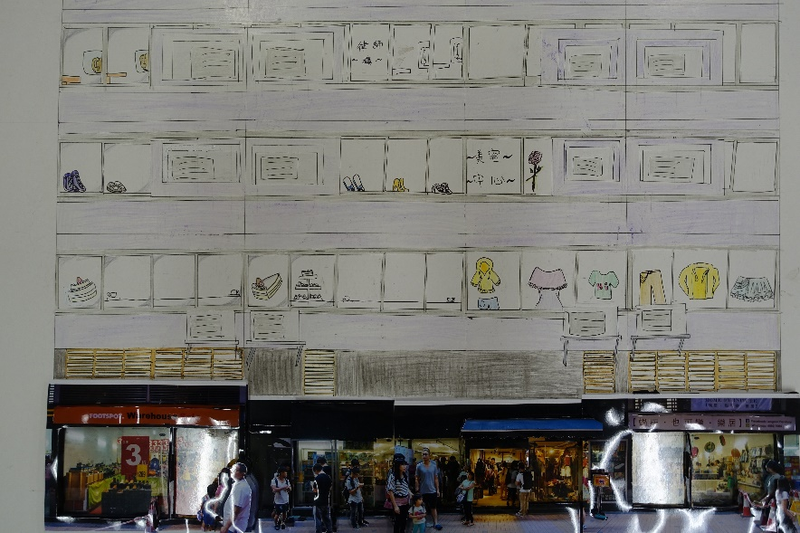
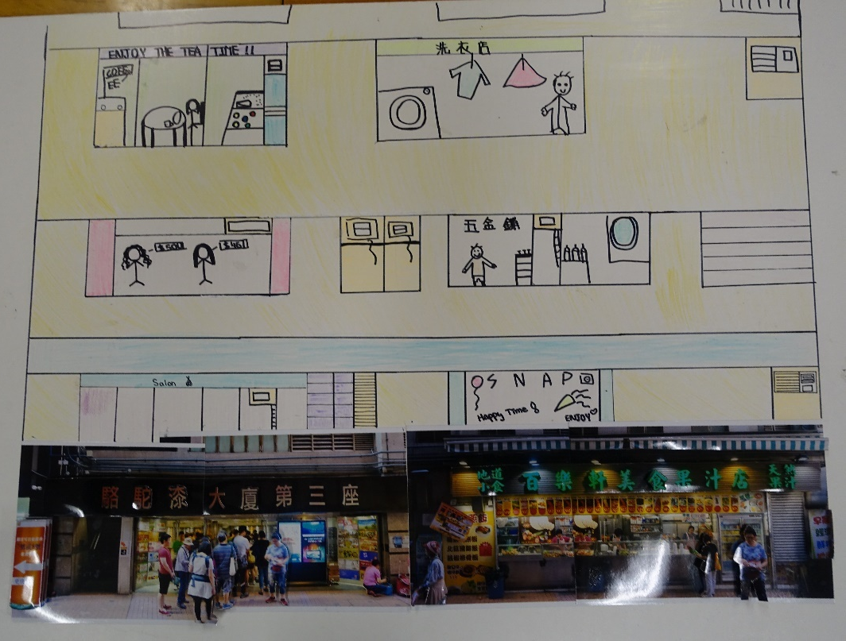
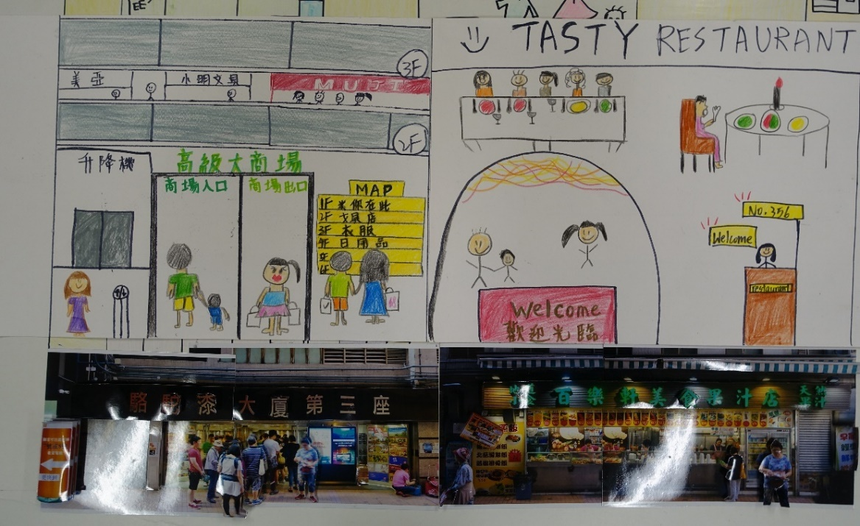
Food Chain Store
Shopping Mall

Slide 16
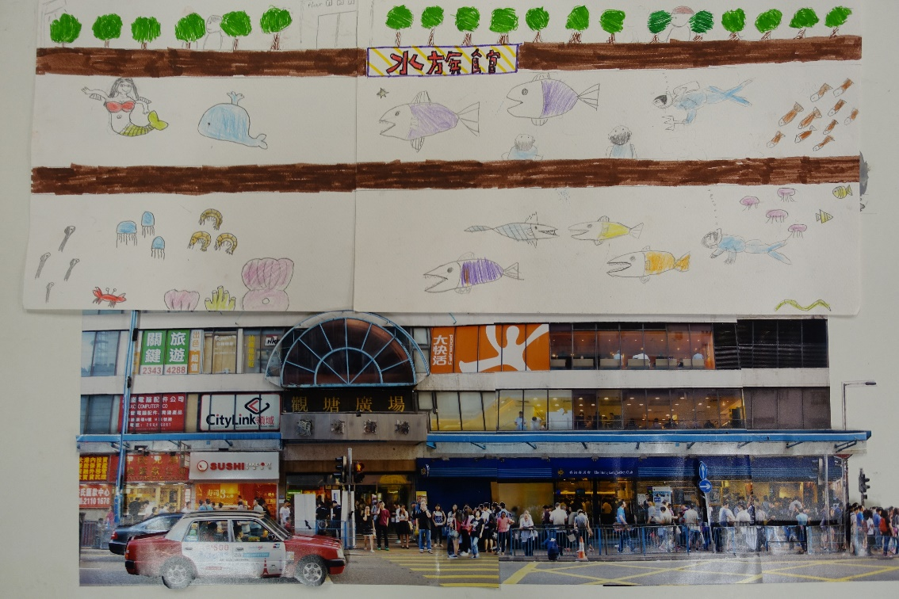
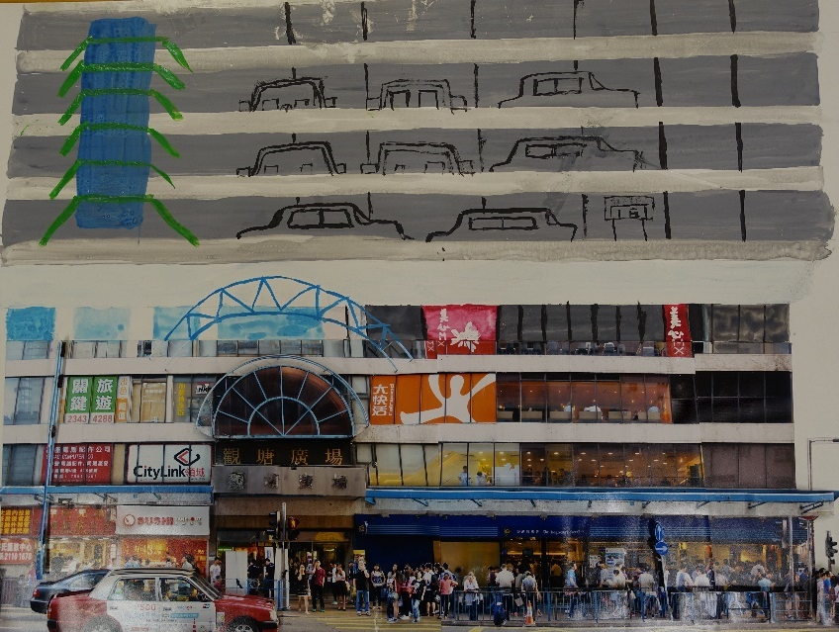
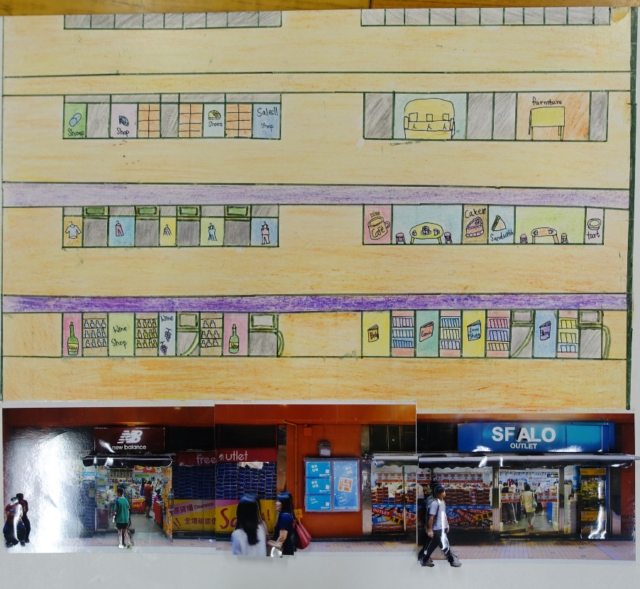
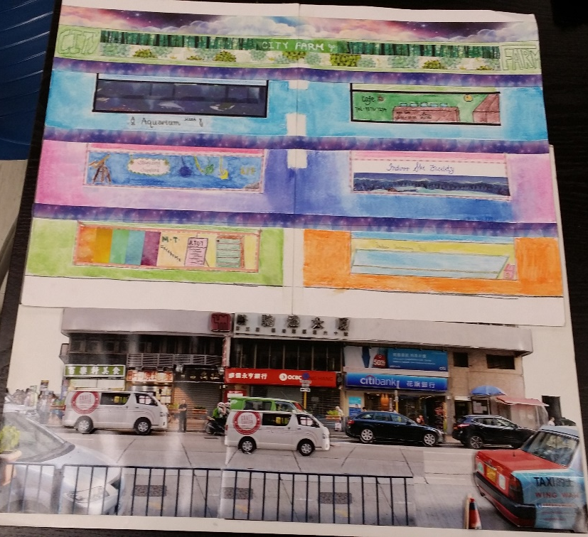
Aquarium
Different type of shops

Slide 17
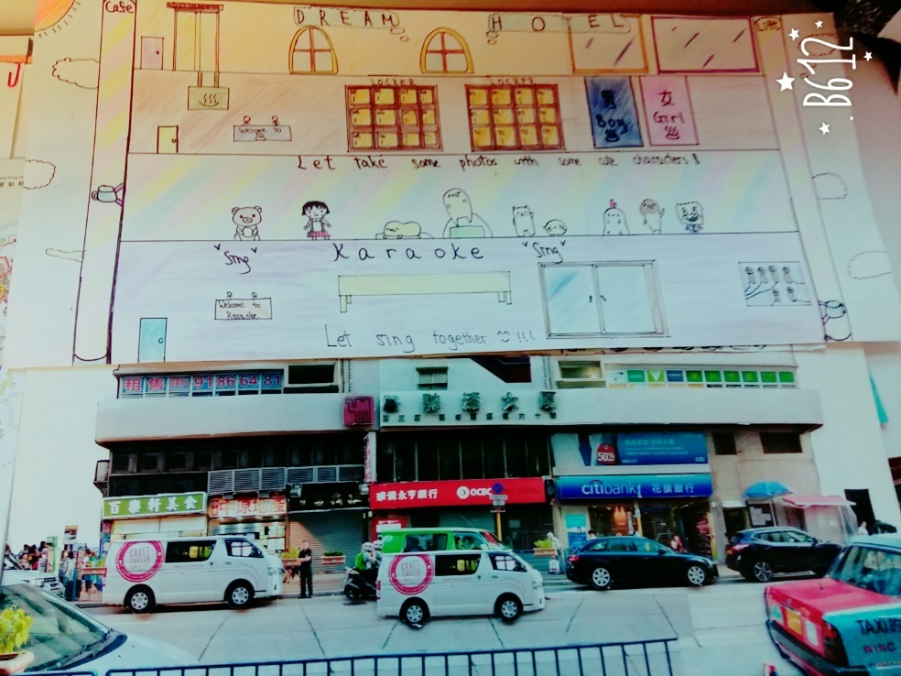
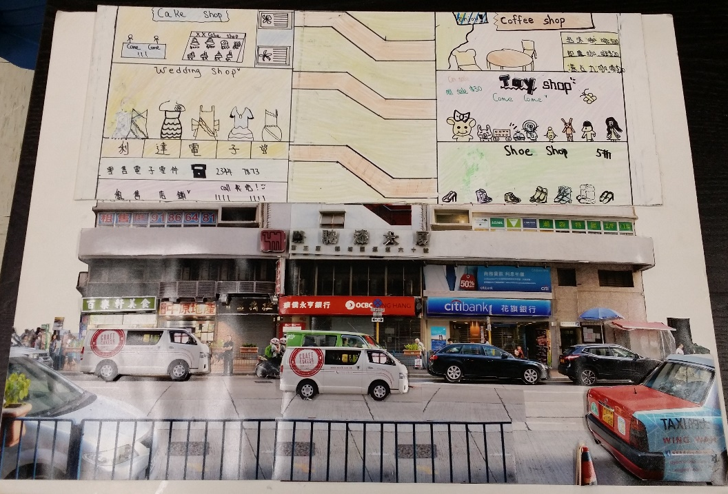
The above are the Present Kwun Tong and your DREAM Kwun Tong.
But, the future of Kwun Tong is…….
Karaoke/hotel
香港故事-走過觀塘五十年
[街導時光機系列] 觀塘－開源道(現在及未來篇)

Slide 18
Peer Assessment Results
Minion | 77 | 53 | 59 | 74 | 67.5 | 63 | 56 | 47 | 56 | 61.4 | 56 | 117.4
Gp 7 | 44 | 51 | 49 | 43 | 47 | 47 | 42 | 47 | 45 | 46.1 | 36 | 82.1
貢橙擋貢和割 | 73 | 51 | 68 | 12 | 64 | 64 | 70 | 48 | 60 | 56.7 | 55 | 111.7
I don’t know | 66 |  | 55 | 37 | 56 | 50 | 38 | 39 | 54.5 | 49.4 | 45 | 94.4
 | 50 | 45 | 53 | 19 | 46 | 47 | 52 | 38 | 37 | 43 | 35 | 78
毒男廢青組 | 72 | 68 | 61 | 55 | 65 | 56 | 37 | 48 | 39 | 55.7 | 39 | 94.7
Chubby Mcdull Guide | 88 | 52 | 76 | 63 | 69 | 70 | 73 | 55 | 64 | 67.8 | 67 | 134.8
Gentle Degenerate | 75 | 59 | 63 | 52 | 67 | 45 | 62 | 46 | 43 | 56.9 | 56 | 112.9
Black Cat |  |  | 70 | 58 | 59 | 65 | 72 | 45 | 61 | 61.4 | 59 | 120.4

