Slide 1
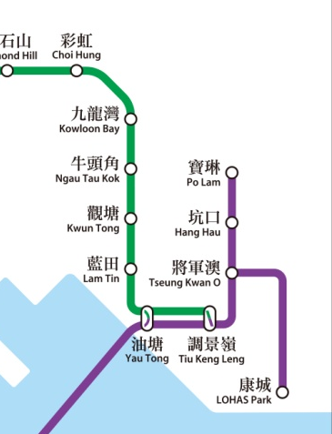
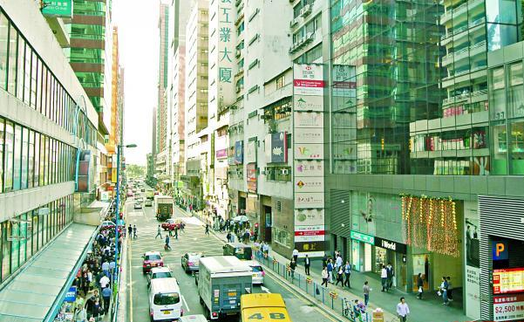
Geography
Global Shift of Manufacturing Industries

Slide 2
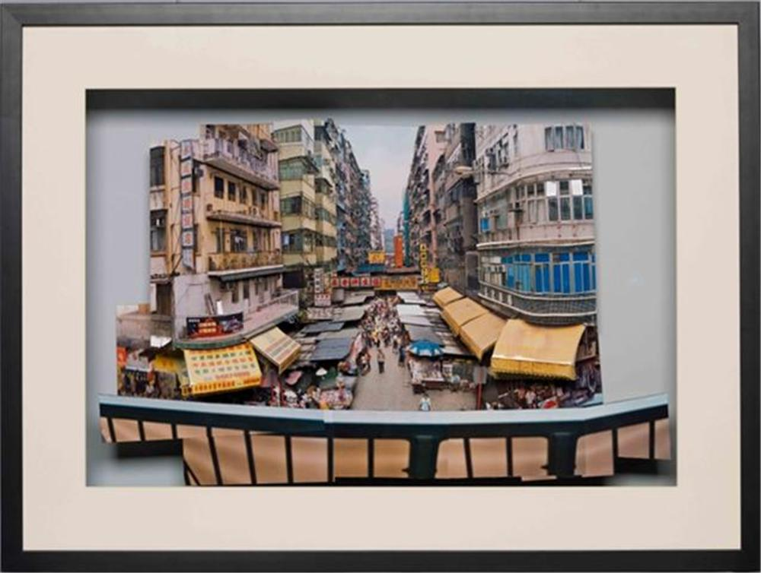
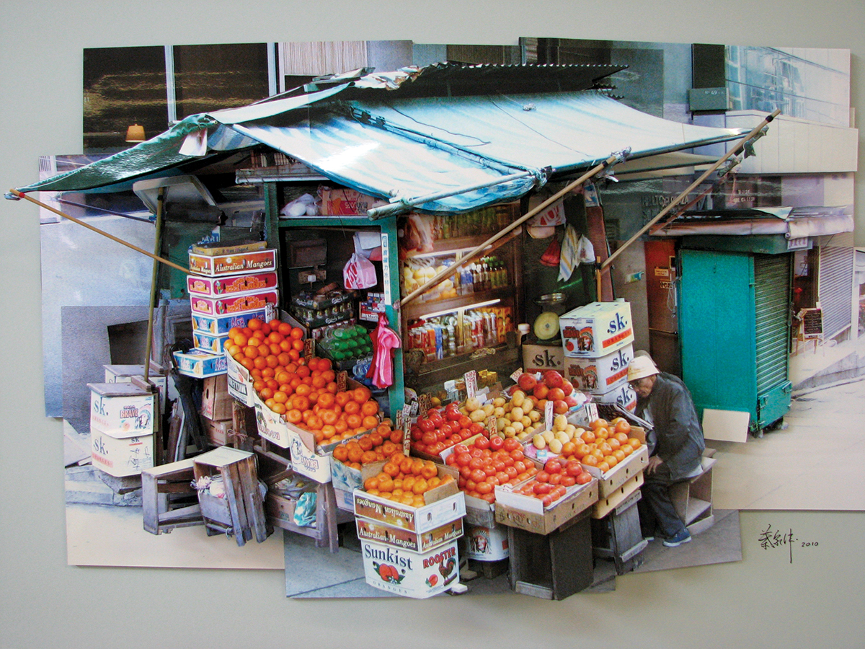
Stage 1 - Fotomo making
(製造立體相片模型)
You will finish the fotomo during VA lessons in 4 lessons (2 cycles).

Slide 3
Stage 2 – Site visit and record
Purpose
to understand the changes of manufacturing industries in Hong Kong (Economic Restructuring)
To understand the change and development of Kwun Tong (Kowloon East)
Present your work /observation use model building

Slide 4
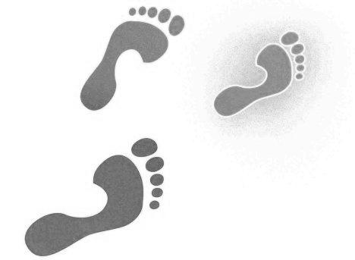

Our route
Exit B2

Slide 5
Shops that your group needs to take photo
Group | Section
毒男廢青 | 爭鮮 + 觀塘廣場 + 投注站
自由騎士組 | 恒生銀行 源成中心
斯文敗類 | 駱駝漆大廈 蛋撻王
MINION | 莎莎 + 巷 + 百樂軒小食店 + 銀行
貢橙檔貢和割 | 銀行之後的地區
我不知 | 上落貨區
肥騰騰麥兜團 | V Puma + Outlets (二至三間)
BLACK CAT | Sketchers + 駱駝漆大廈第三座
第七組 | 百樂軒小食店

Slide 6
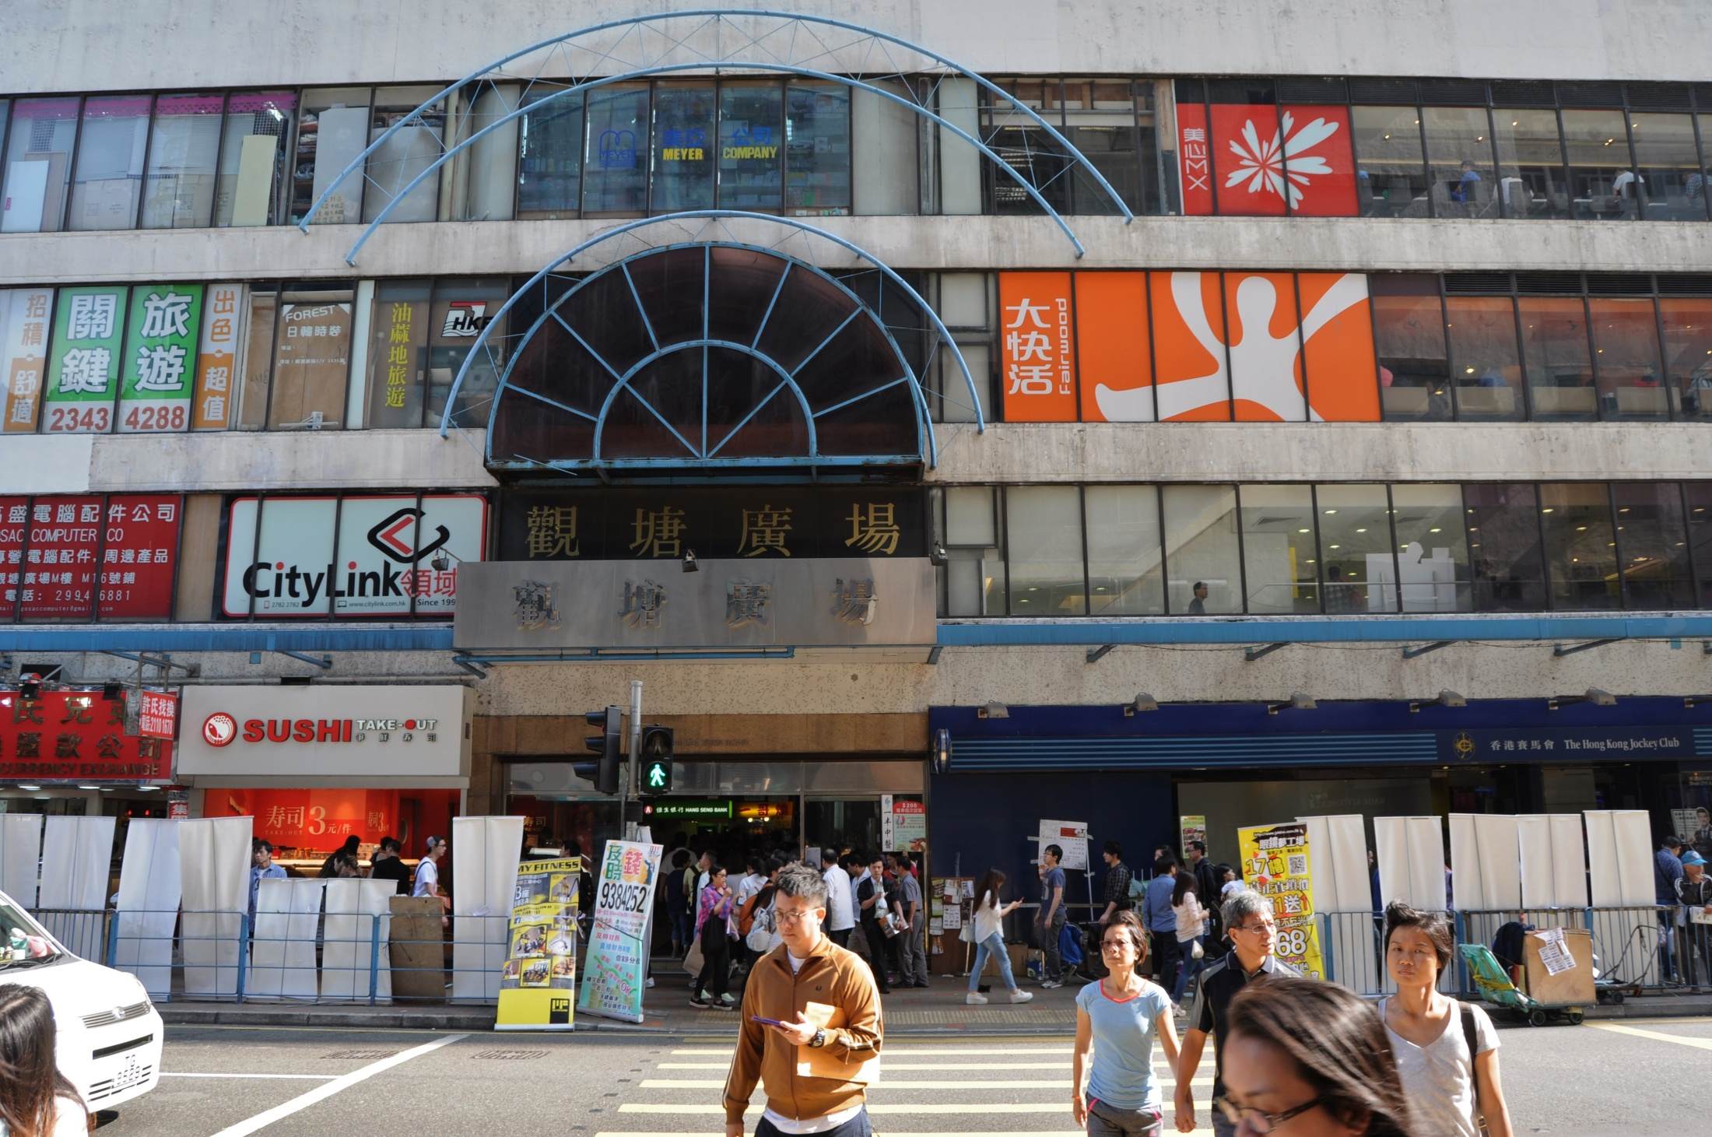

Slide 7
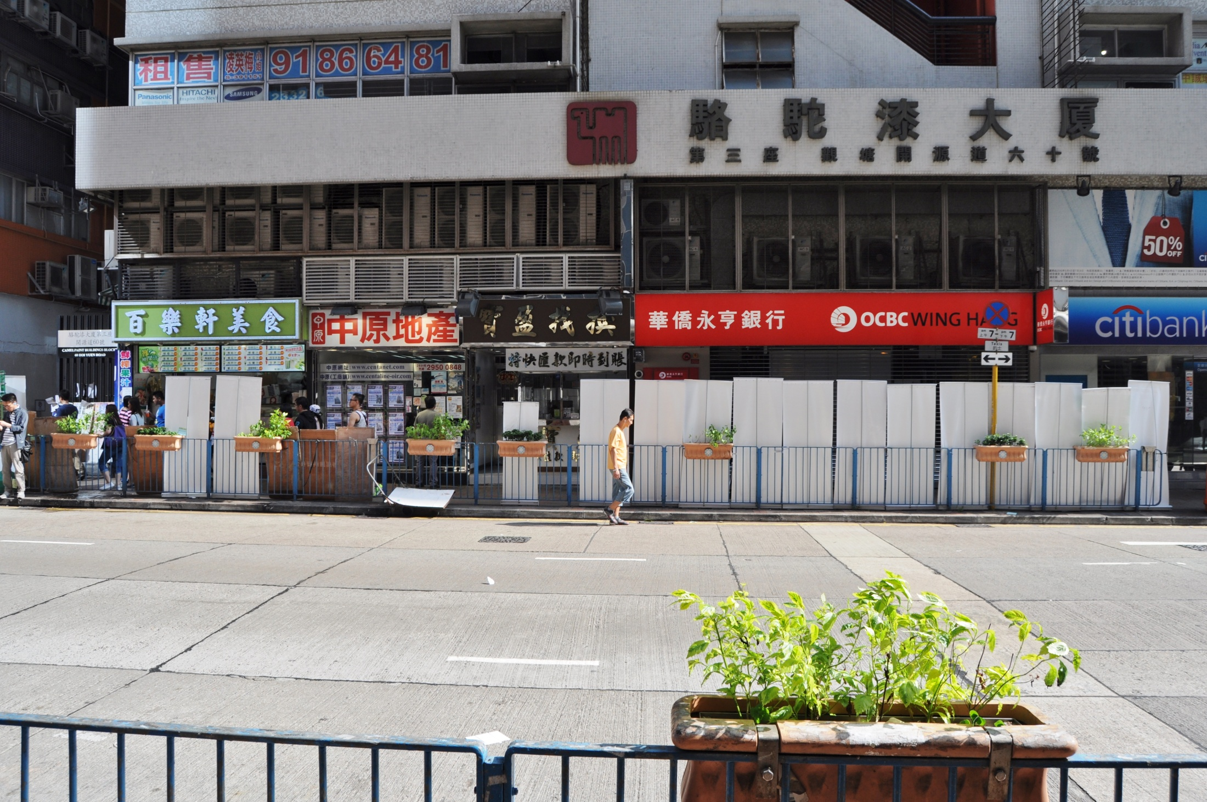

Slide 8
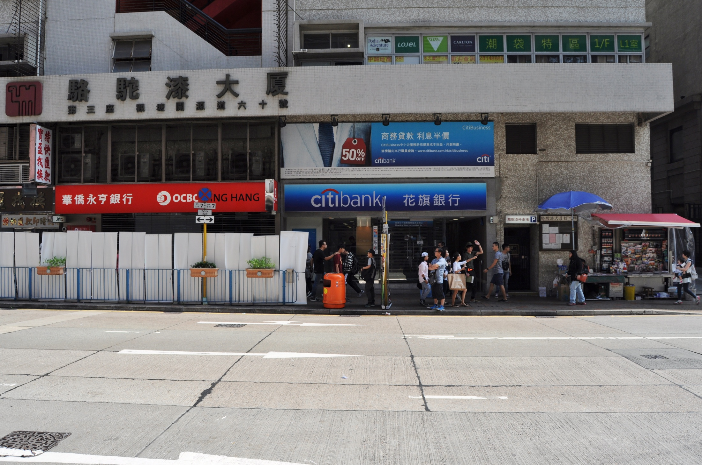

Slide 9
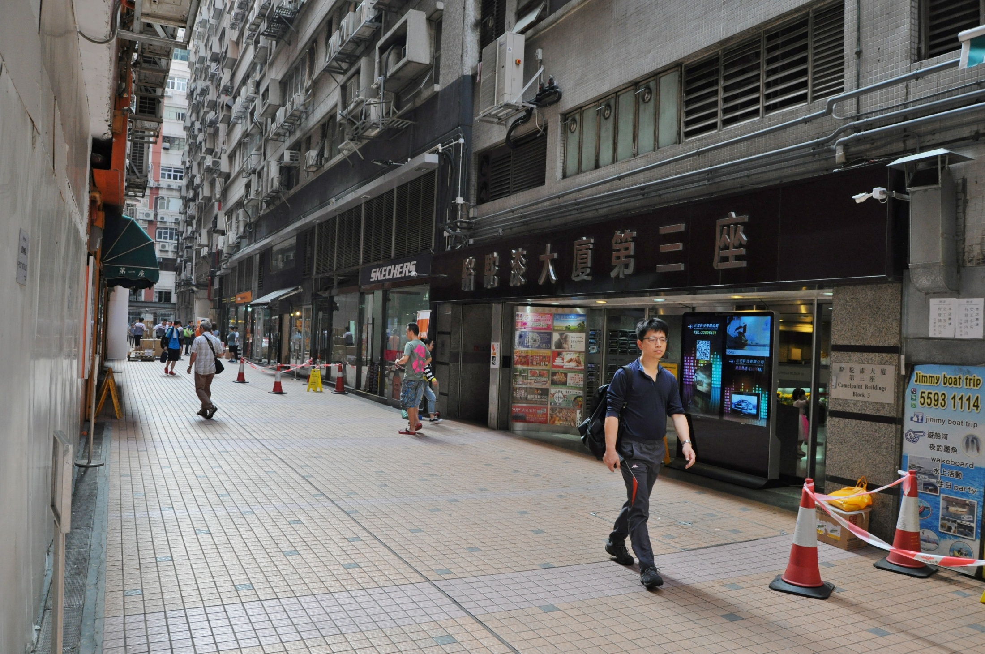

Slide 10
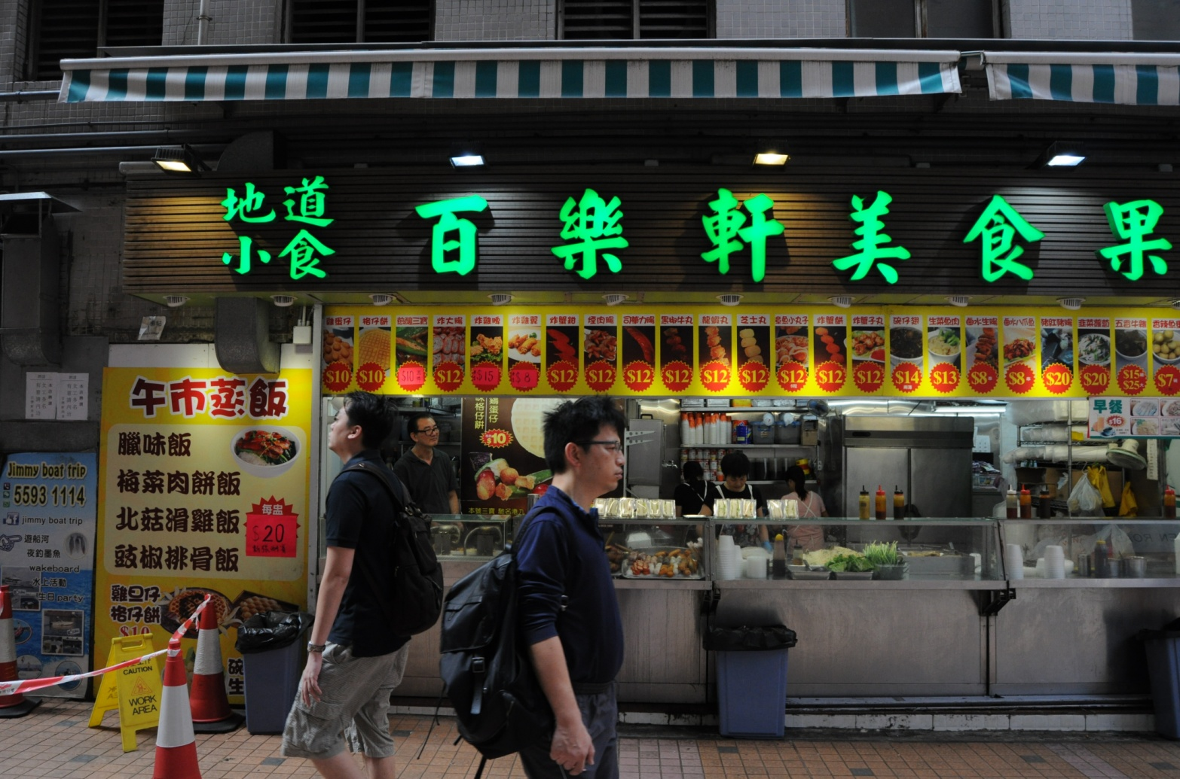
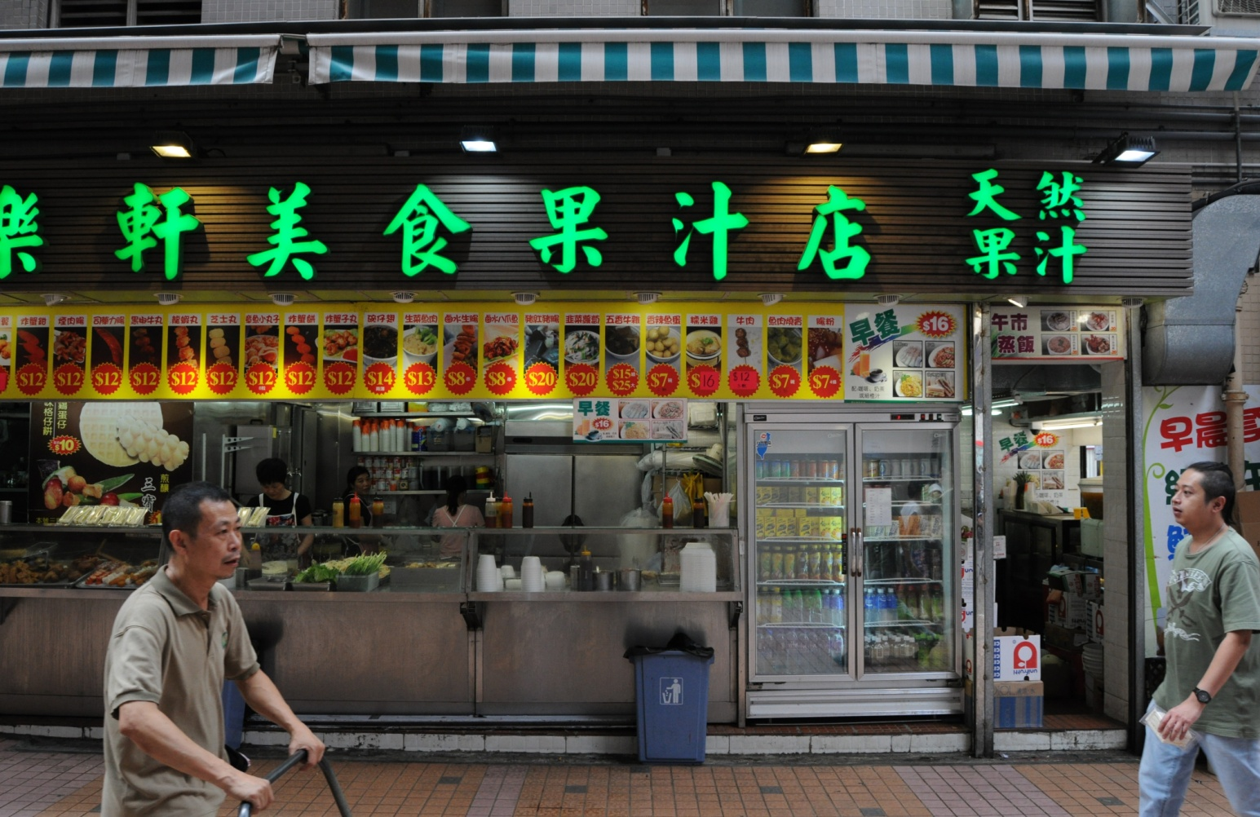

Slide 11
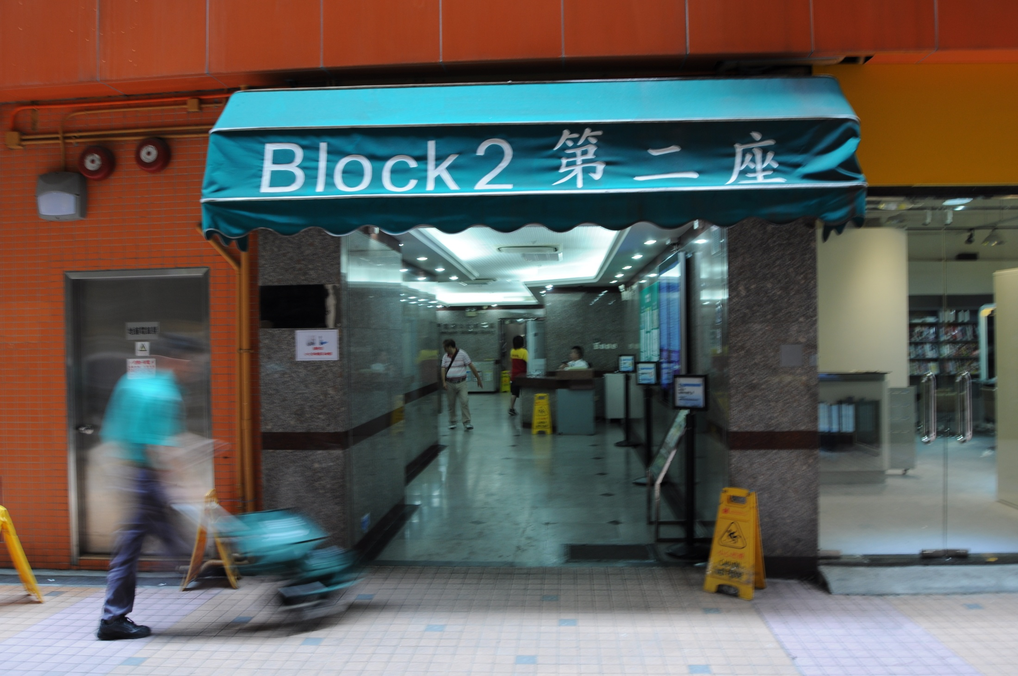
留意快門速度，1/6 sec

Slide 12
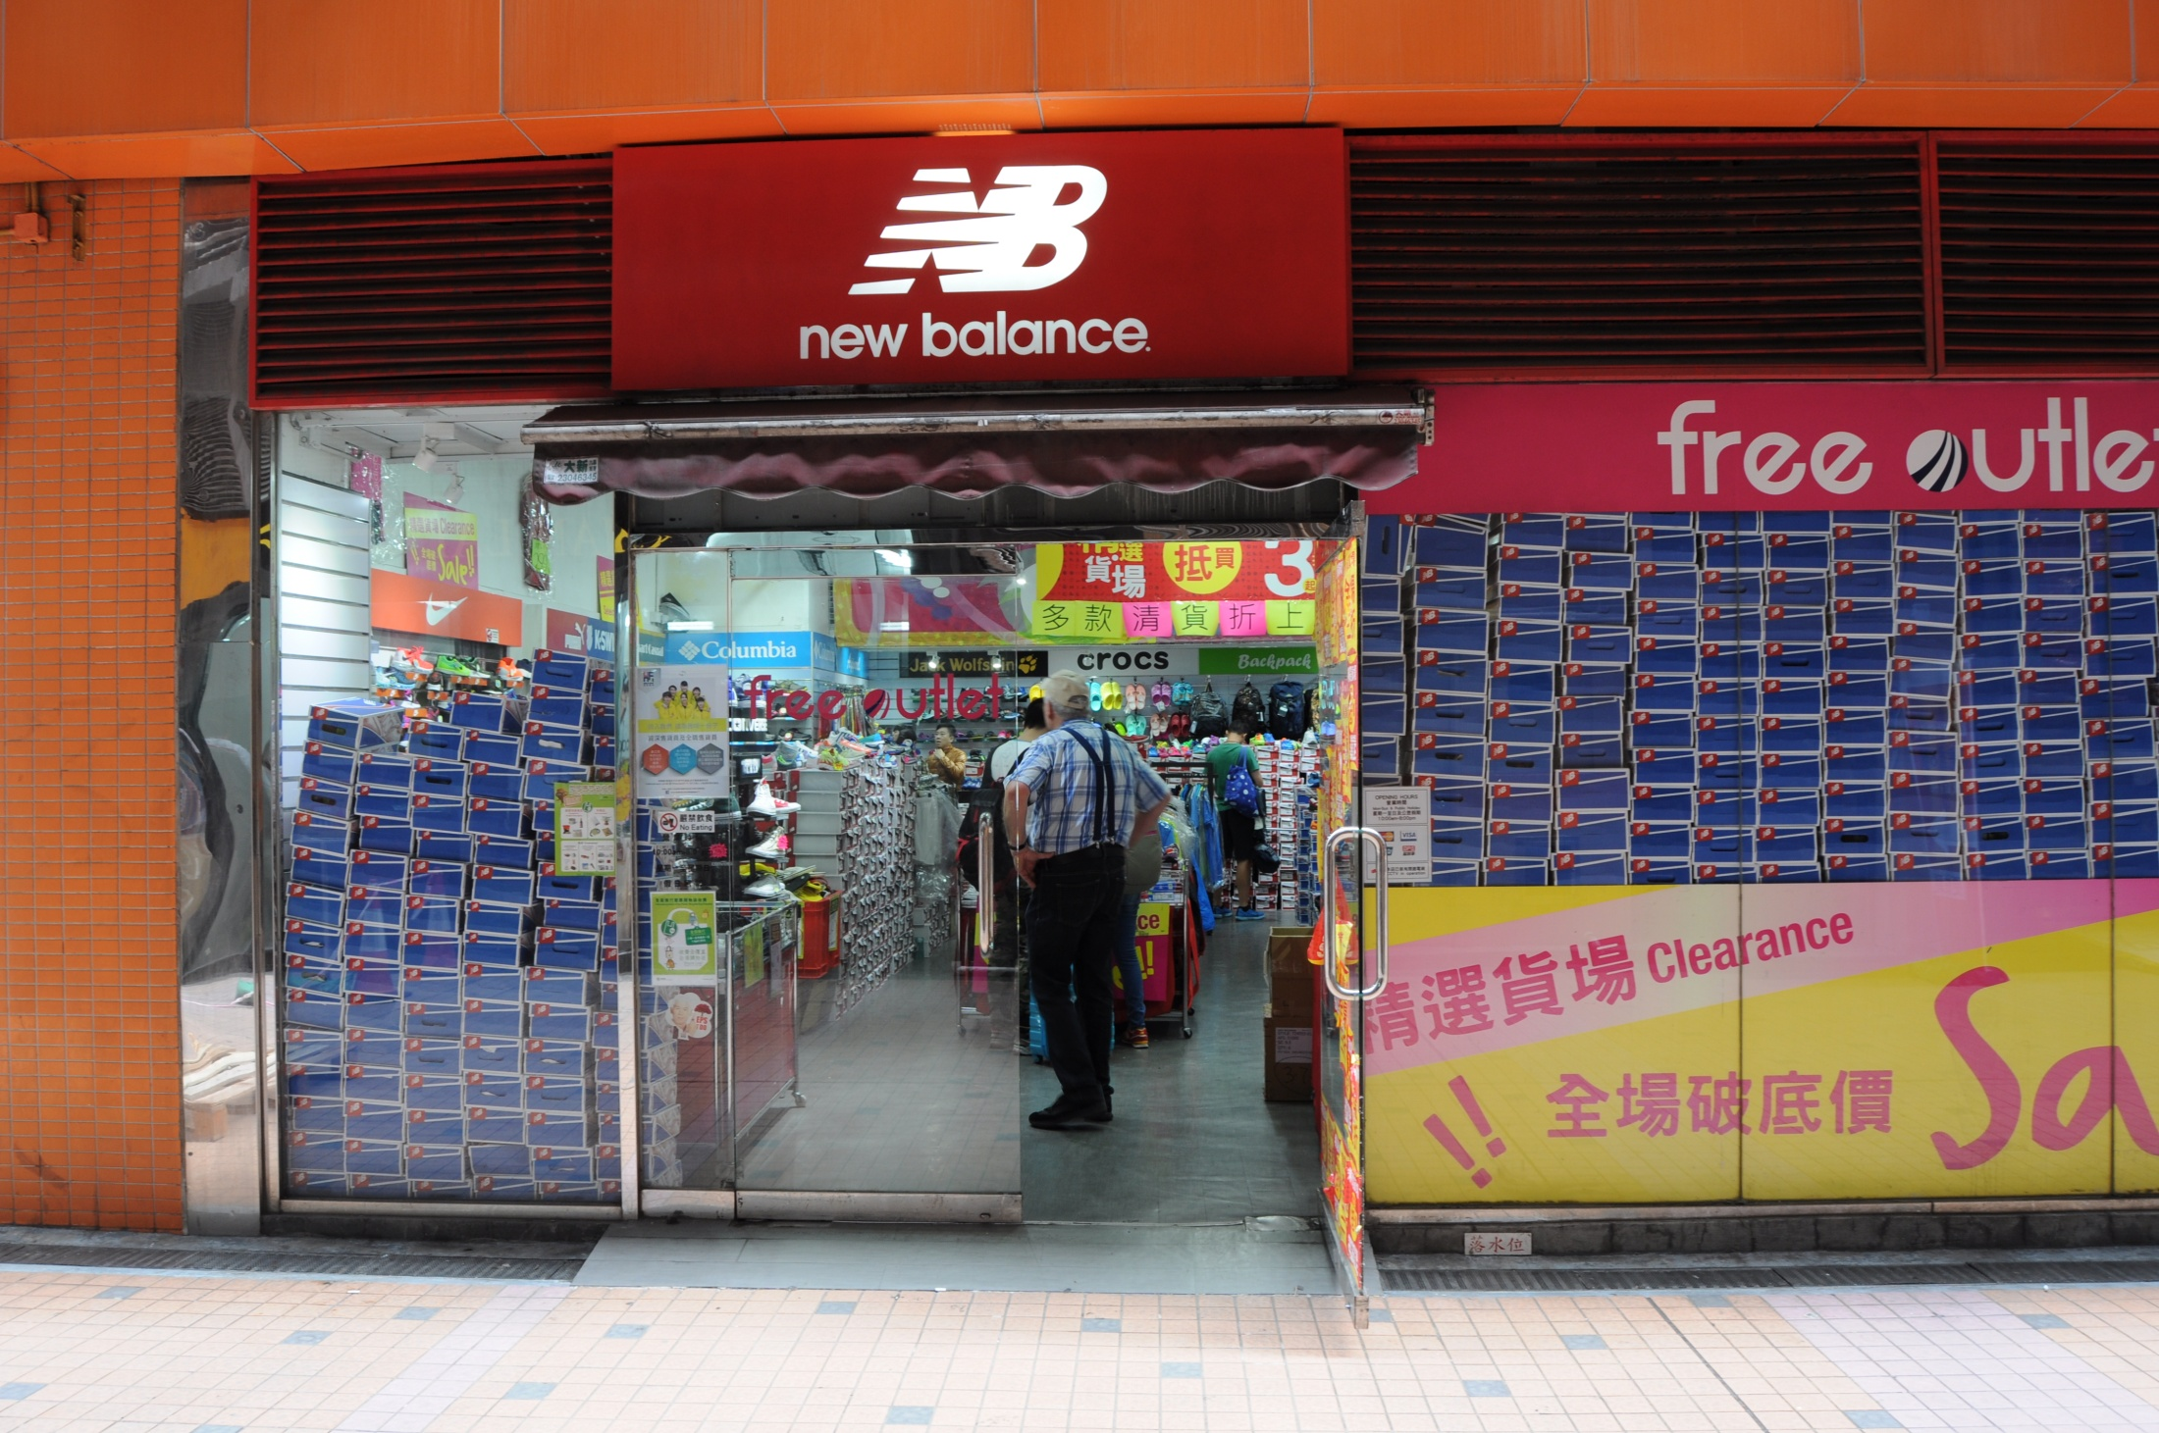

Slide 13
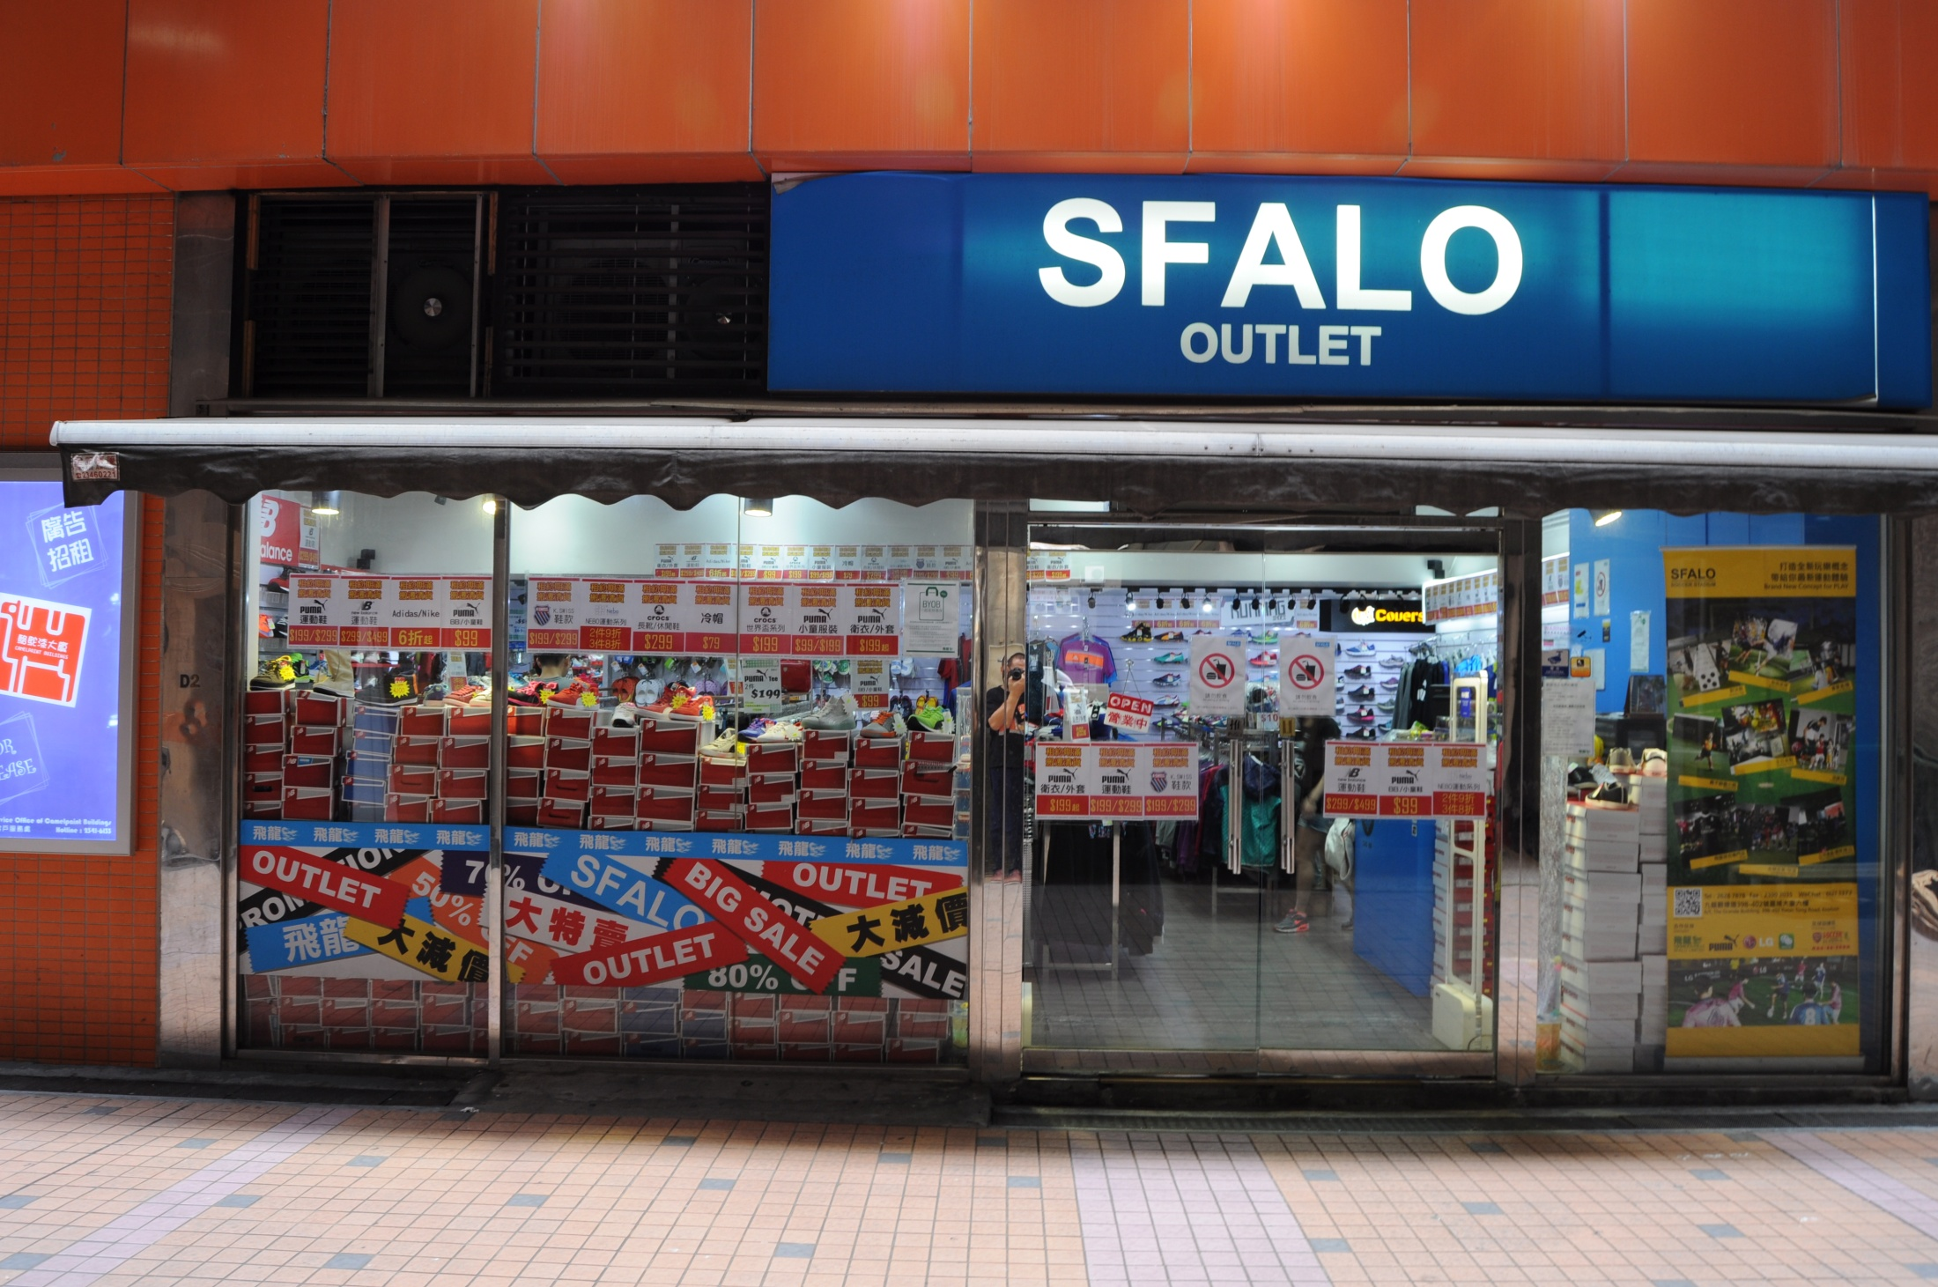

Slide 14
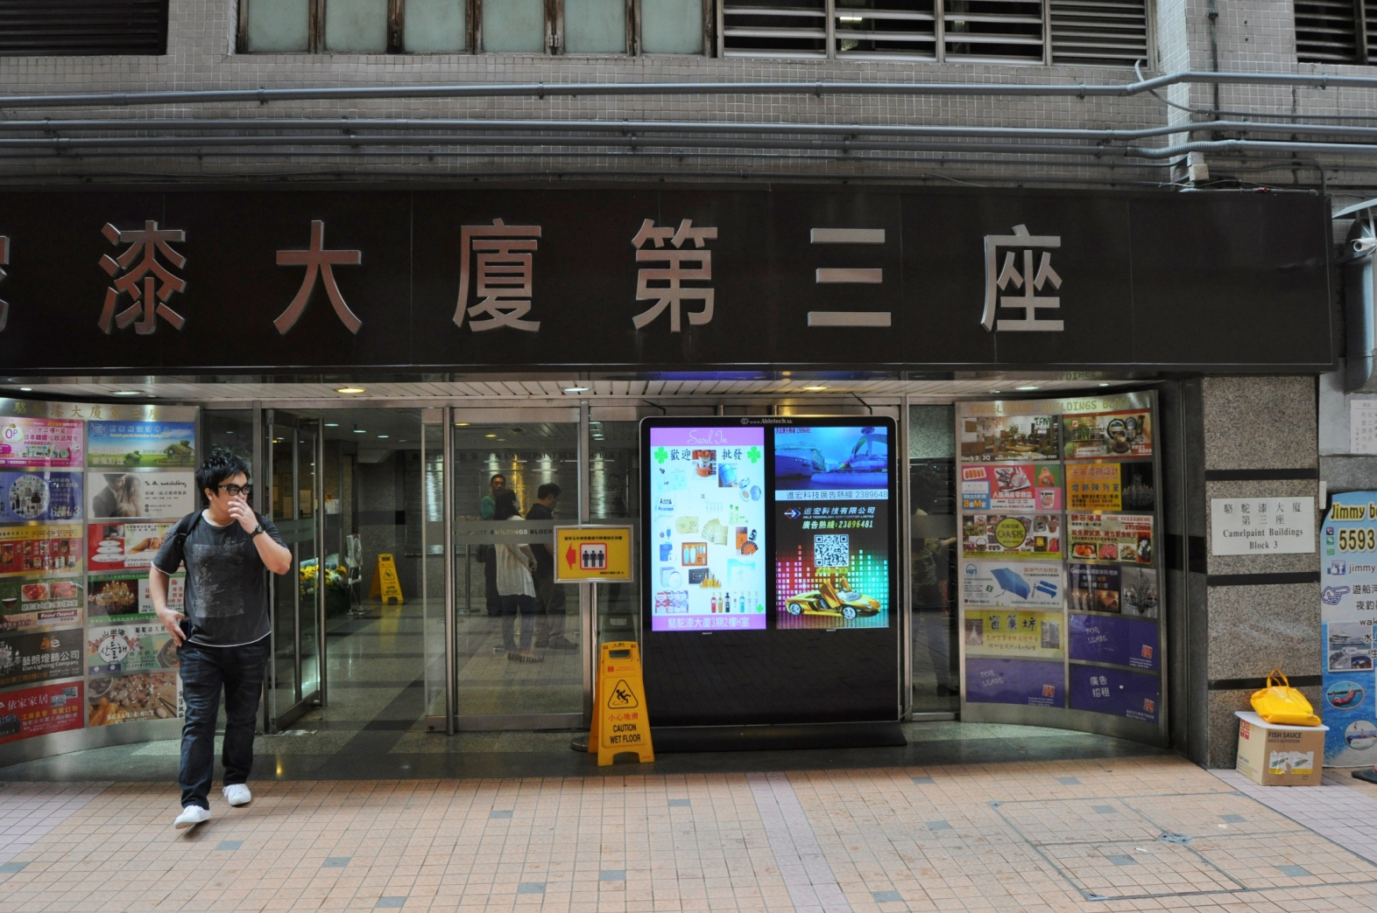
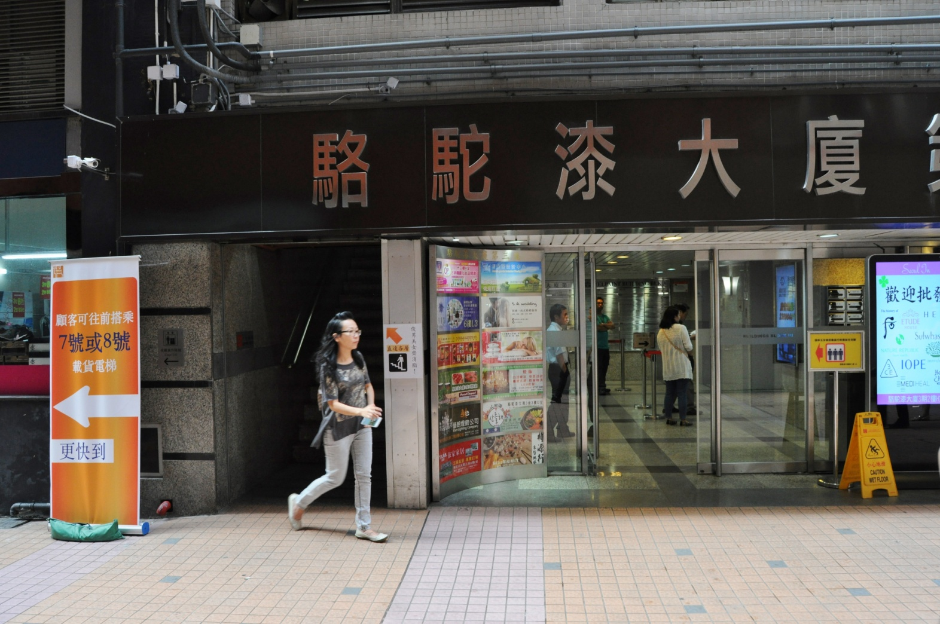

Slide 15

5 Senses Writing (五感法)

Slide 16
Worksheet

Slide 17
Stage 3 – Presentation through Fotomo
Each group have 5 minutes to present what you have observed through the site visit.
You can use your own knowledge and what you have learnt in Unit 1 to deliver your presentation
Peer marking

Slide 18
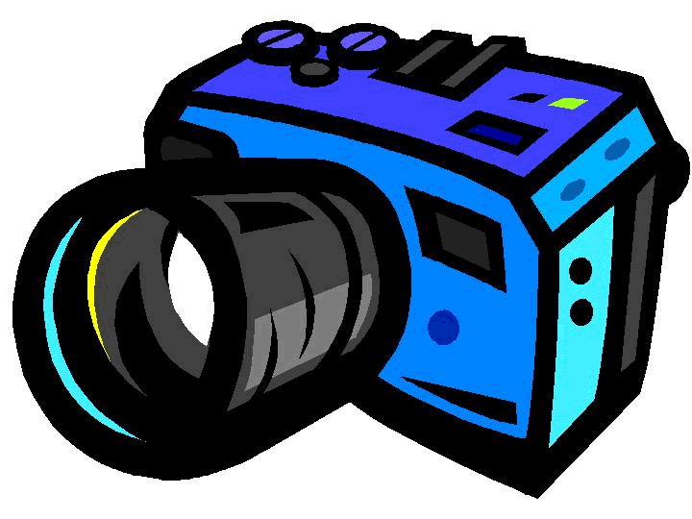
Preparation for site visit
Camera
(provided by school ) □
2. Worksheet
(will be given on the day of visit) □
3. Stationery □

