Slide 1


How long does it take to travel
from A to B?
It takes an hour by bus
and twenty minutes by taxi.
How far is it from A to B?
It’s not far. It’s one and a half kilometres.
It’s a long way. It’s four kilometres.

Slide 2
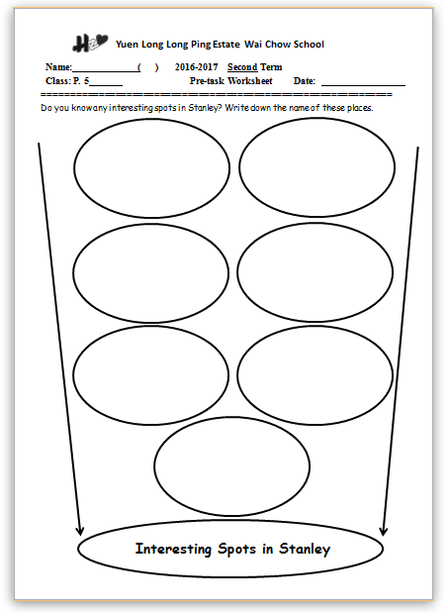
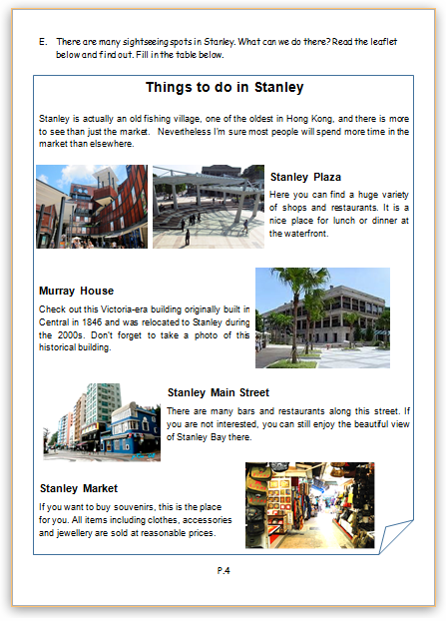
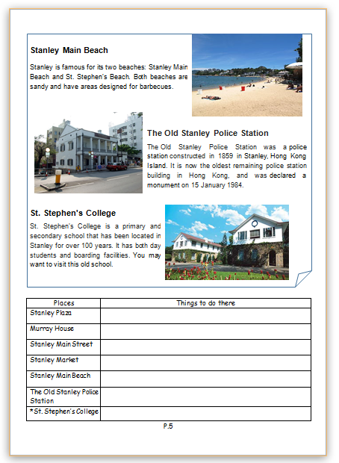

Slide 3
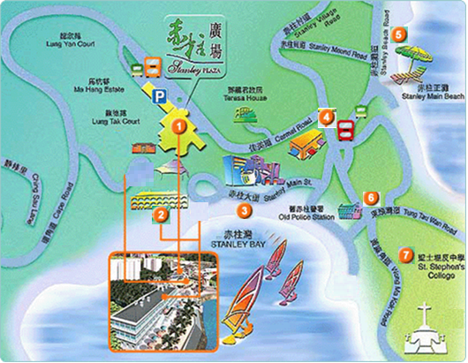
Interesting Spots in Stanley
Stanley Plaza
Murray House
Stanley Main Street
Stanley Market
Stanley Main Beach
The Old Stanley Police Station
St. Stephen’s College
You are here.

Slide 4
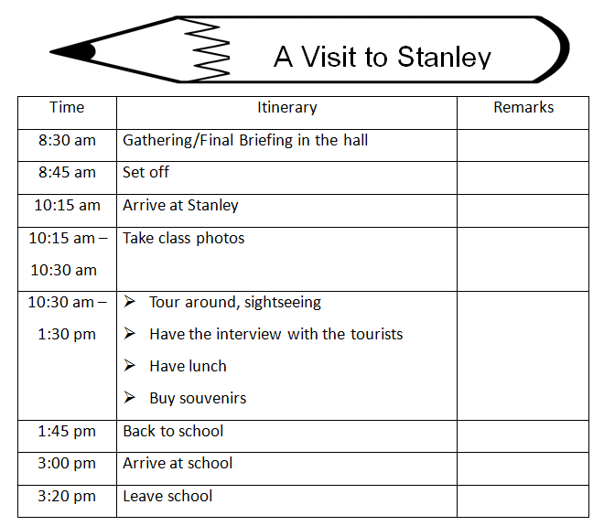

Problem
We only have three hours to spend there!

Slide 5

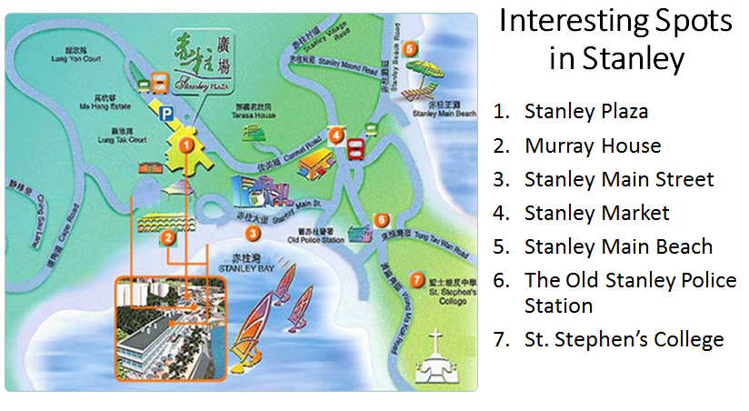
Let’s suggest some places to go!

I suggest going…
I don’t suggest going…


Slide 6
Let’s suggest some places to go!
Knowing the distance and the duration help us decide where to go.
What questions should we ask?
Distance
(km/m)
How far is it from A to B?
Duration
(hour/
minutes)
How long does it take to travel from A to B?

Slide 7
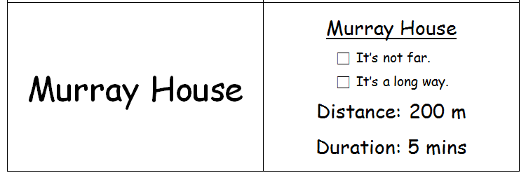

Task:
Find out the distance and duration by asking your friends. Then give your suggestions.
More than 500 metres → a long way

Slide 8
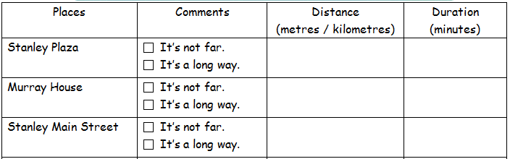

200 m
5 mins
You are here.

Slide 9


5 minutes

Slide 10

Now, write down your suggestions.
(Write at least 2 places)
Where do/don’t you suggest going? Why?
How far is it from the carpark?
How long does it take to walk there?
(  What do you want to do there? )

Slide 11
Now, write down your suggestions.

I suggest going to _____________ because it is not far. It is _____________ metres from the carpark. It takes _______________ minutes to walk there.
Murray House
200
two hundred
five
5
I want to take a
photo of the historical building there.

I don’t suggest going to _____________ because it is a long way. It is _____________ metres from the carpark. It takes _________ minutes to walk there.
St. Stephen’s College

200 m
5 mins

Slide 12
I suggest going to _____________ because it is not far. It is ____metres from the carpark. It takes _____ minutes to walk there.

Murray House
I want to take a photo of the historical building there.
too
I suggest going to _____________ because it is not far. It is ____metres from the carpark. It takes _____ minutes to walk there.
Stanley Market

I want to buy souvenirs there.
also

I suggest going to _____________ because …

Moreover,
I suggest going to _____________ because …

Slide 13
Now, write down your suggestions.

I don’t suggest going to _____________ because it is a long way. It is _____________ metres from the carpark. It takes _________ minutes to walk there.
St. Stephen’s College
either

I don’t suggest going to _____________ because it is a long way. It is _____________ metres from the carpark. It takes _________ minutes to walk there.
Stanley Main Beach

Slide 14

5 minutes

Slide 15
Now, write down your suggestions.
(Write about at least 2 places)
Where do/don’t you suggest going? Why?
How far is it from the carpark?
How long does it take to walk there?
(  What do you want to do there? )

Slide 16

We want to listen to your opinion! ☺

Slide 17


Our Suggestions
In our next lesson, we are going to write a letter to Principal Sung. We will give suggestions on our visit to Stanley.

